Slide 1

Ethics of Digital Marketing
Ethics of Business and Digital-Marketing

Slide 2

What is ethics?
The discipline dealing with what is good and bad and with moral duty and obligation.
What is the difference between moral and ethic?
Ethics refer to rules provided by an external source, eg. codes of conduct in workplaces or principles in religions.
Morals refer to an individual’s own principle regarding right or wrong

Slide 3
Approach to dealing with ethical issues
Virtues Ethics Approach
The virtues approach to decision making focuses on how you should behave and think about relationship if you are concerned with your daily life in community
The assumption is that people are guided by their virtues to reach the right decision.
Utilitarian Approach
The Utilitarian Approach to the ethical decision making states that you should choose the action or the policy that has the best overall consequences for all the people who are directly or indirectly affected

Slide 4
Approach to dealing with ethical issues
Fairness Approach
Fairness Approach focuses on how fairly actions and polices distributes benefits and burdens among people affected by the decision.
The guiding principle of this approach is to treat all people the same.
Common Good Approach
The common good approach to the decision making is based in a vision of society as a community whose member works together to achieve a common set of values and goals

Slide 5


“ Ethics in Business “
Ethics is becoming more and more important in the business world.
Financial institutes due to unwise and unethical decision making regarding the approval of mortgages, loans and lines to unqualified individuals and organizations.
Numerous corporate officers and senior managers have been sentenced to prison terms for their unethical behaviors.
Organization are sorely tempted to resort to unethical behavior to maintain profit

Slide 6

What is Digital Marketing
Digital Marketing is the marketing of products or services using digital technologies, mainly on the Internet, but also including mobile phones, display advertising and any other digital medium.

Slide 7
“ Organization of Digital- Marketing Company “

Slide 8
“ Ethical issues in Digital Marketing ”
The Quality of your content
The Quality of your product
Consider implication
Representing your brand correctly
Email Correspondences
Virtue ethics concerns
Transparency
Ownership of information
Privacy of Customers

Slide 9
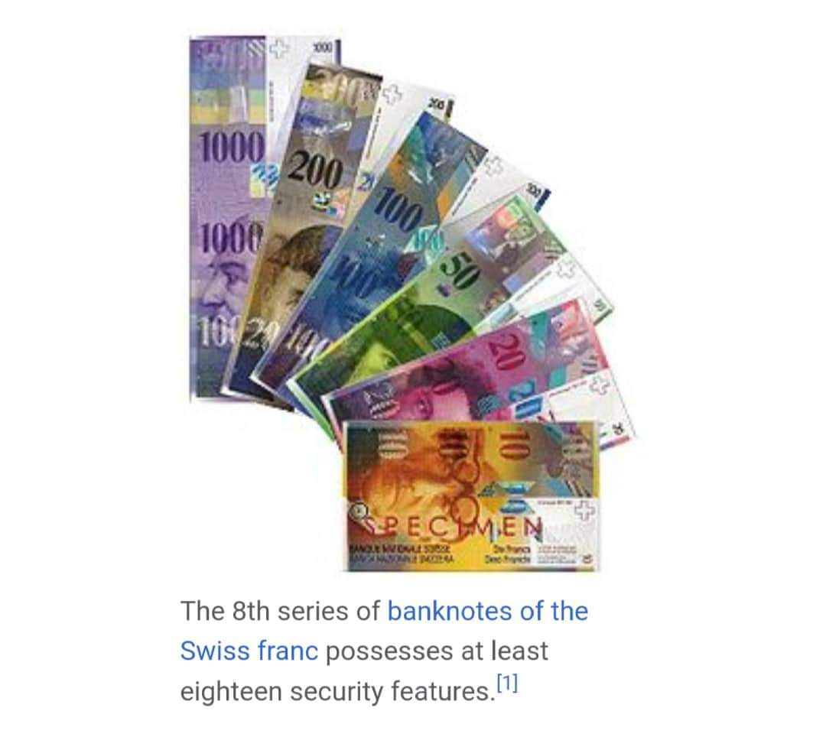
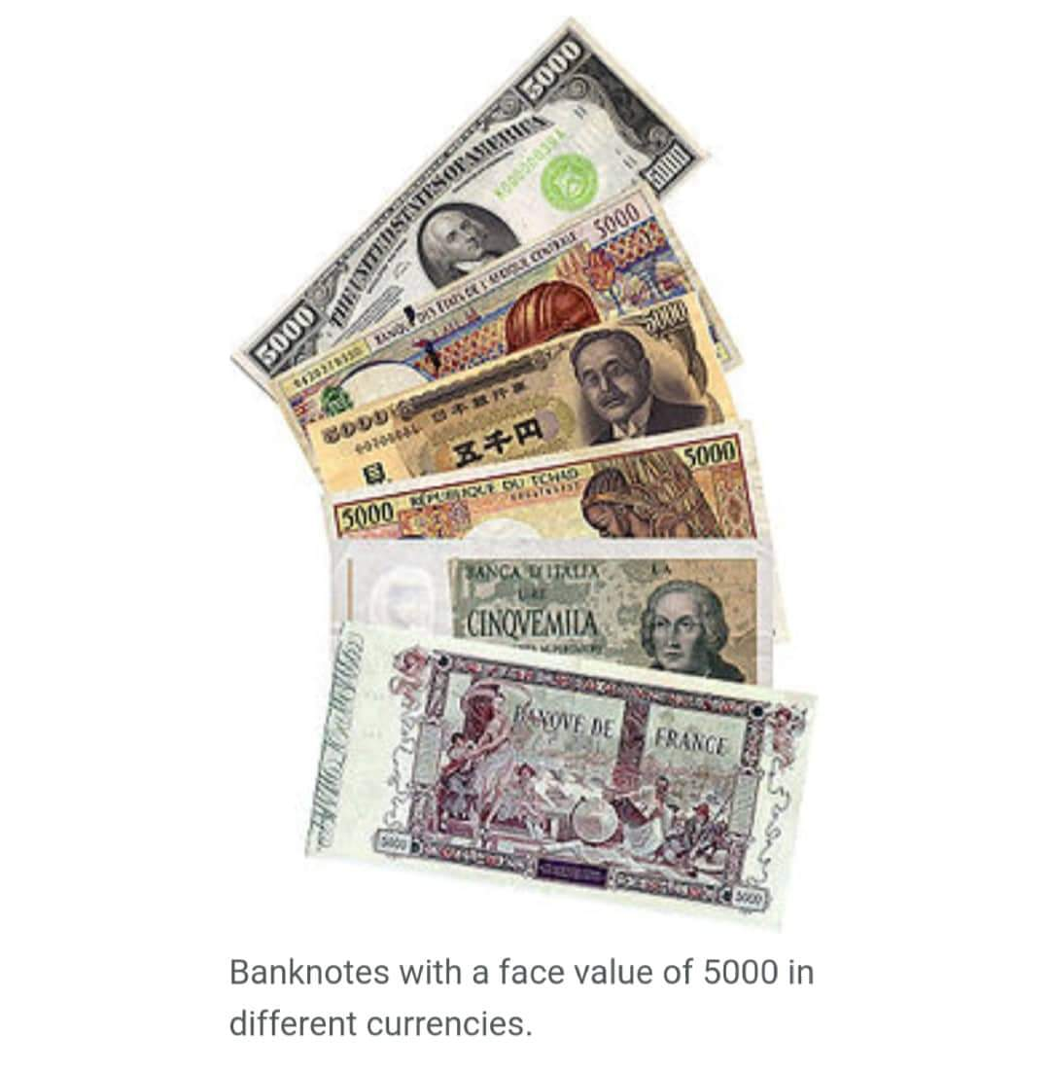
About Digital Currency
Digital Currency, among its various names in electronic money that acts as alternative currency. Alternative digital currencies are not produced by government, endorsed central banks.
Digital Currency or Electronic currency is a type of currency available in digital form such as banknotes and coins.

Slide 10
About Digital Currency
Example include virtual currencies and cryptocurrencies and control bank issued money occurred for in computer database.
These currencies may be used to buy physical goods and services
Digital currency is a money balance recorded electrically on a stored-value cord or other devices.
Digital currency is network money, allowing the transfer of value on computer networks.

Slide 11





Most used Social Media Platform for Digital Marketing

Slide 12
Why use Digital Marketing in business?
Business use digital marketing to increase Sates and Revenue. Business’ man goal for digital marketing is to make money.
Large business use Digital marketing to stand out from the competition because they already have established brand awareness and want to encourage potential customers to convert
Digital marketing helps business differentiate themselves from the competition

Slide 13
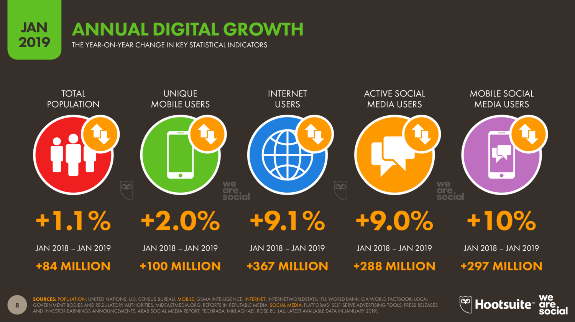
Growth of Digital Marketing

Slide 14
Future of Digital marketing
Technology is integrated into our lives more than even before we are used to buy products from conversation AI devices Amazon Alex, Google Home and Online Shop. According to world records, 61% of marketers using digital platform for selling and promoting their products.
The scope of Digital Marketing provides some of the most powerful techniques whereas traditional marketing fails to do. It is undoubtedly it’s clear that there is a great scope for Digital Marketing in the future.

Slide 15

Thank
YOU^^
Any
Question?

